Slide 1



UNIT 6: Around the world
The wind and
the sun

Slide 2
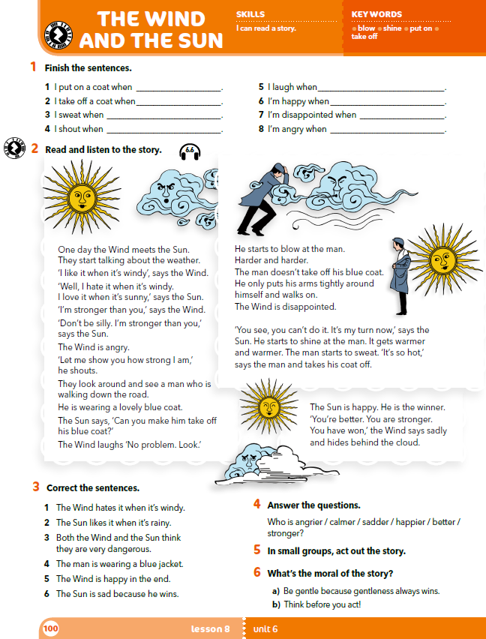
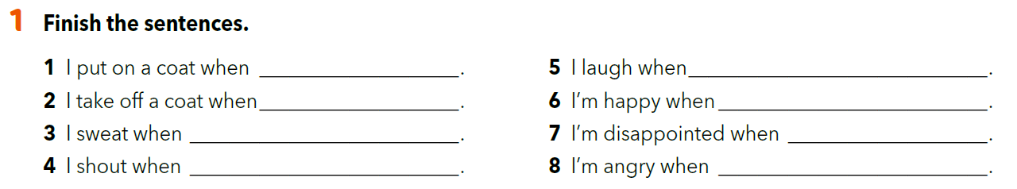
Finish the sentences as if you were your classmate.
When you finish, read the sentences to your classmate and check your answers.

Slide 3
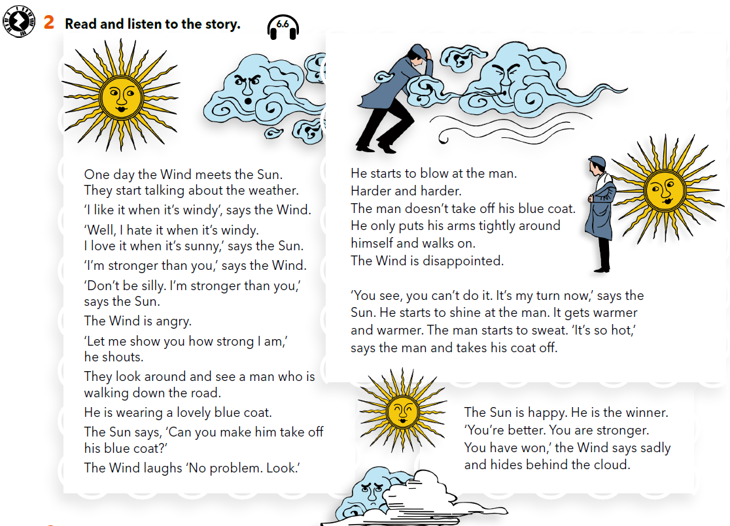

What does the Wind do?
Does the man take off his coat?
How does the Wind feel?
What does the Sun do?
Does the man take off his coat?
How does the Sun feel?
Who won?
How does the Wind feel?
Who is on the road?
What is he wearing?
What does the Wind want to do?
Who is talking?
What do they like?
Are they friends?
https://www.e-sfera.hr/dodatni-digitalni-sadrzaji/51fb47f5-1e85-4aac-b1a5-e615c75c39d7/assets/audio/49_the_wind_and_the_sun.mp3

Slide 4
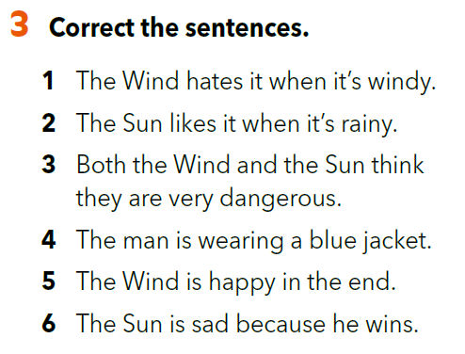
The Wind likes it when it’s windy.
The Sun likes it when it’s sunny.
Both the Wind and the Sun think they are very strong.
The man is wearing a blue coat.
The Wind is sad in the end.
The Sun is happy because he wins.

Slide 5
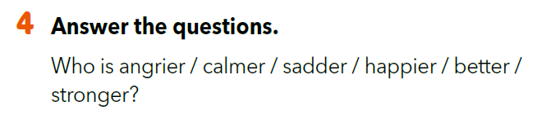

Slide 6

LET’S PRACTISE!
Read the text aloud. Change your voice and read the sentences as if you were:
angry
cold
hot
disappointed
happy

Slide 7
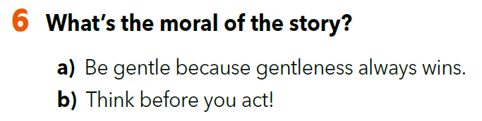
What’s the moral of the story? Explain your answer.

Slide 8
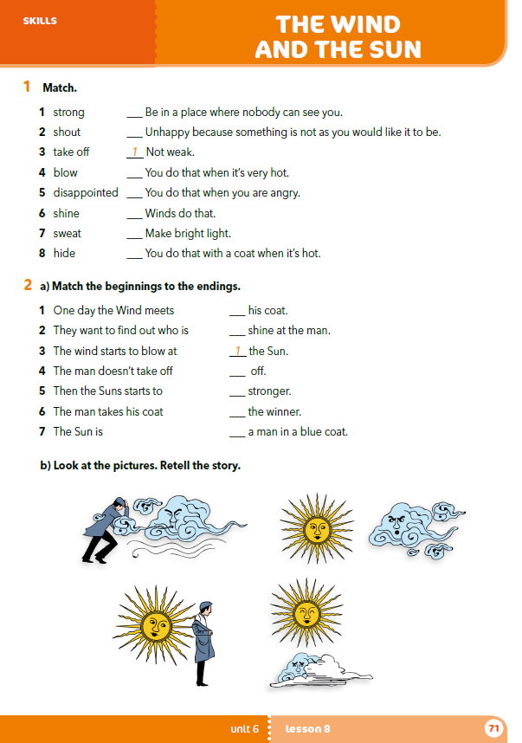
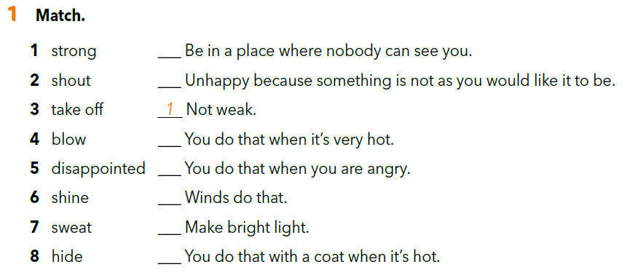
workbook p. 71
8
5
7
2
4
6
3

Slide 9
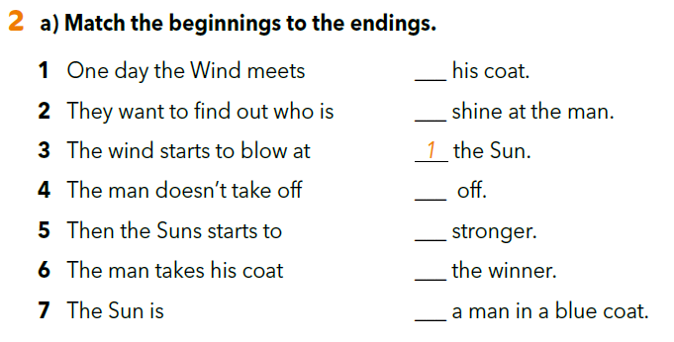
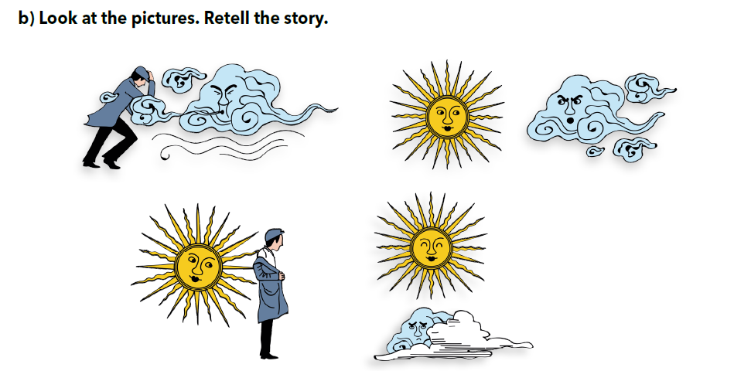
4
5
6
2
7
3

Slide 10

U malim grupama osmislite igrokaz na temelju priče.
Osmislite scenarij.
Podijelite uloge i dogovorite se hoćete li koristiti rekvizite. Kakvi će rekviziti biti?
Kad ste osmislili svoj igrokaz, predajte svoj scenarij učitelju, a vi odglumite priču razredu.

Slide 11
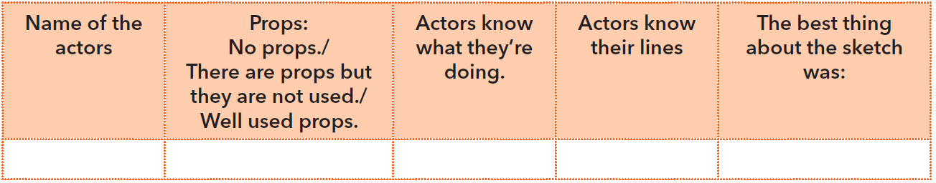
Answer the questions in your notebook.
Which sketch was the best? Why?
What could have they done better in their sketch?

